Slide 1
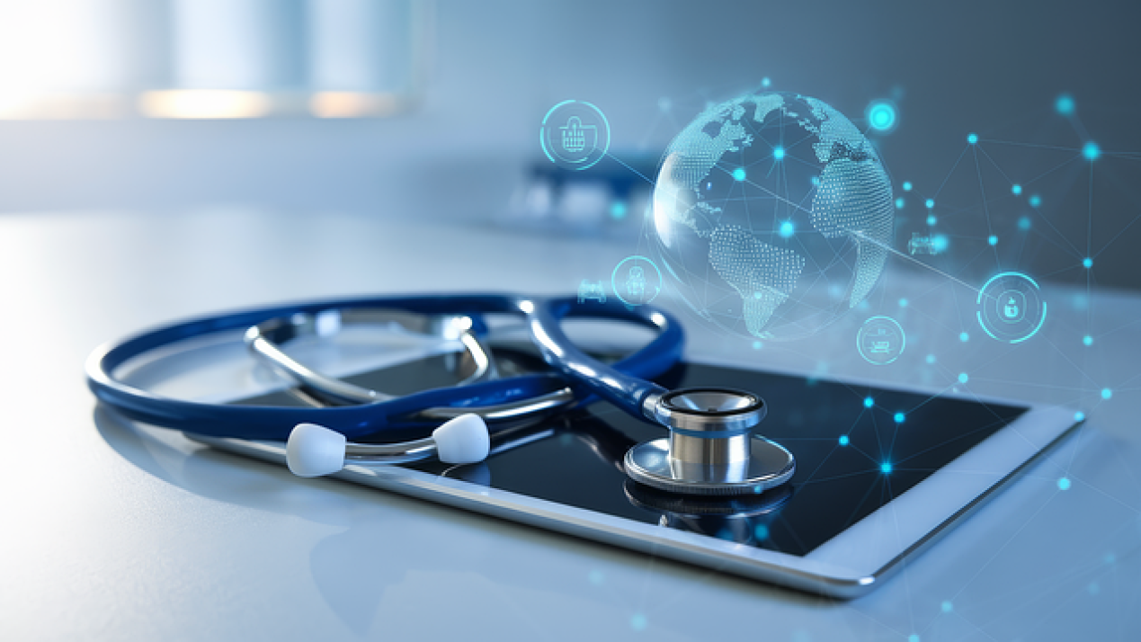
HealthInsight
A Leveraging Machine Learning for Real-Time Healthcare Insights and Patient-Centric Care Decision-Making
HealthInsight leverages real-time data and predictive analytics for early health issue detection, remote monitoring, and improved communication, ensuring accessible, high-quality healthcare for all, including underprivileged communities, to enhance global healthcare standards.
Project Supervisor:
Dr. Sarwar Jahan
Associate Professor
Department of CSE
East West University
Student Name & ID:
Mim Bin Hossain (2021-1-60-071)
Rahma Mahbub (2020-2-60-026)
Saurov Sikder (2021-1-60-053)
Muhammad Sadman Tajwer (2021-1-60-030)
1

Slide 2
Introduction
HealthInsight helps users access real-time healthcare information easily.
It allows booking doctor appointments, checking hospital details, and finding available beds.
AI-powered tools analyze symptoms and suggest the right medical department.
The platform supports telemedicine with digital prescriptions and secure data practices.
Future updates will include smartwatch integration, better AI advice, mental health support, and voice commands.
2

Slide 3


Objectives
Automation: HealthInsight uses AI to handle tasks like symptom checking, doctor recommendations, and appointment scheduling automatically, reducing wait times and manual effort.
Efficiency: The platform provides quick access to real-time data on hospital beds, doctor availability and medical costs, helping users and healthcare providers save time and streamline care.
Convenience: Patients can easily book appointments, consult doctors online and receive digital prescriptions, all from their phones or computers.
Accuracy: By using machine learning models, HealthInsight offers reliable disease predictions and tailored health advice, ensuring patients receive correct information for better decision-making.
3

Slide 4
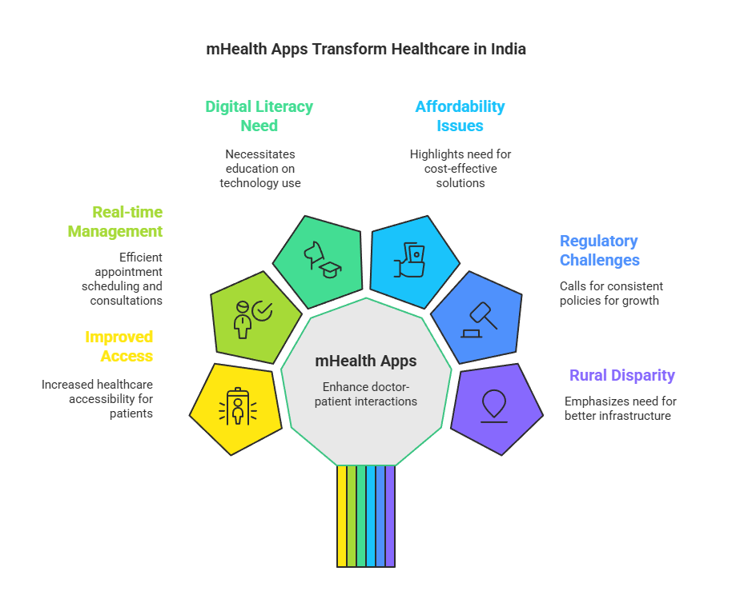
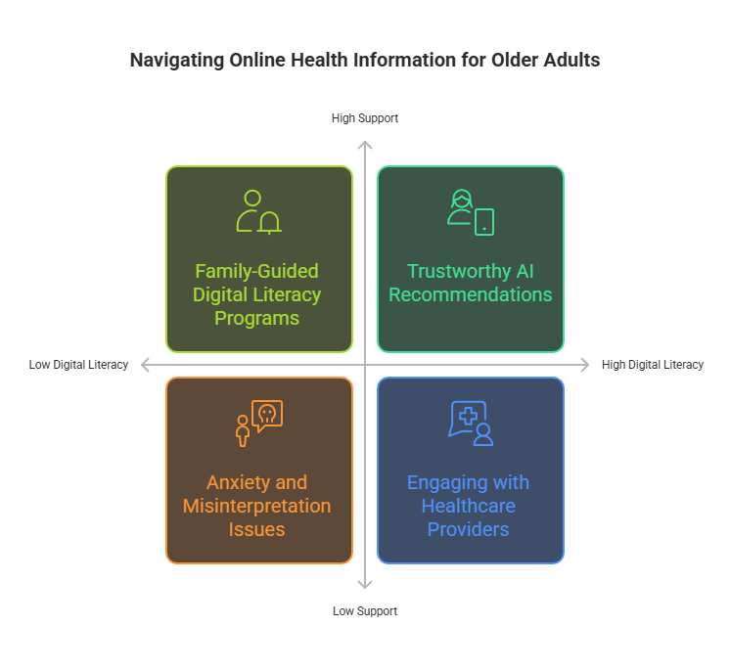
Literature Review
4

Slide 5
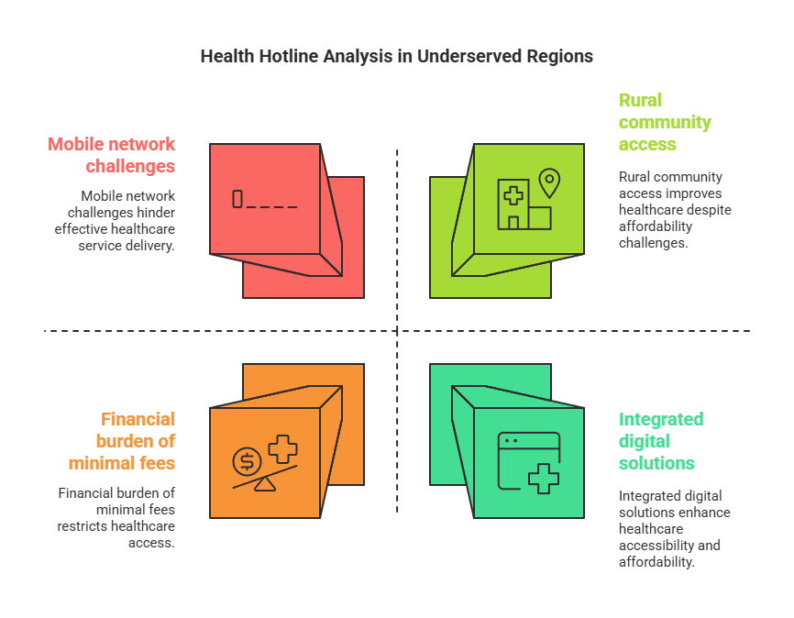
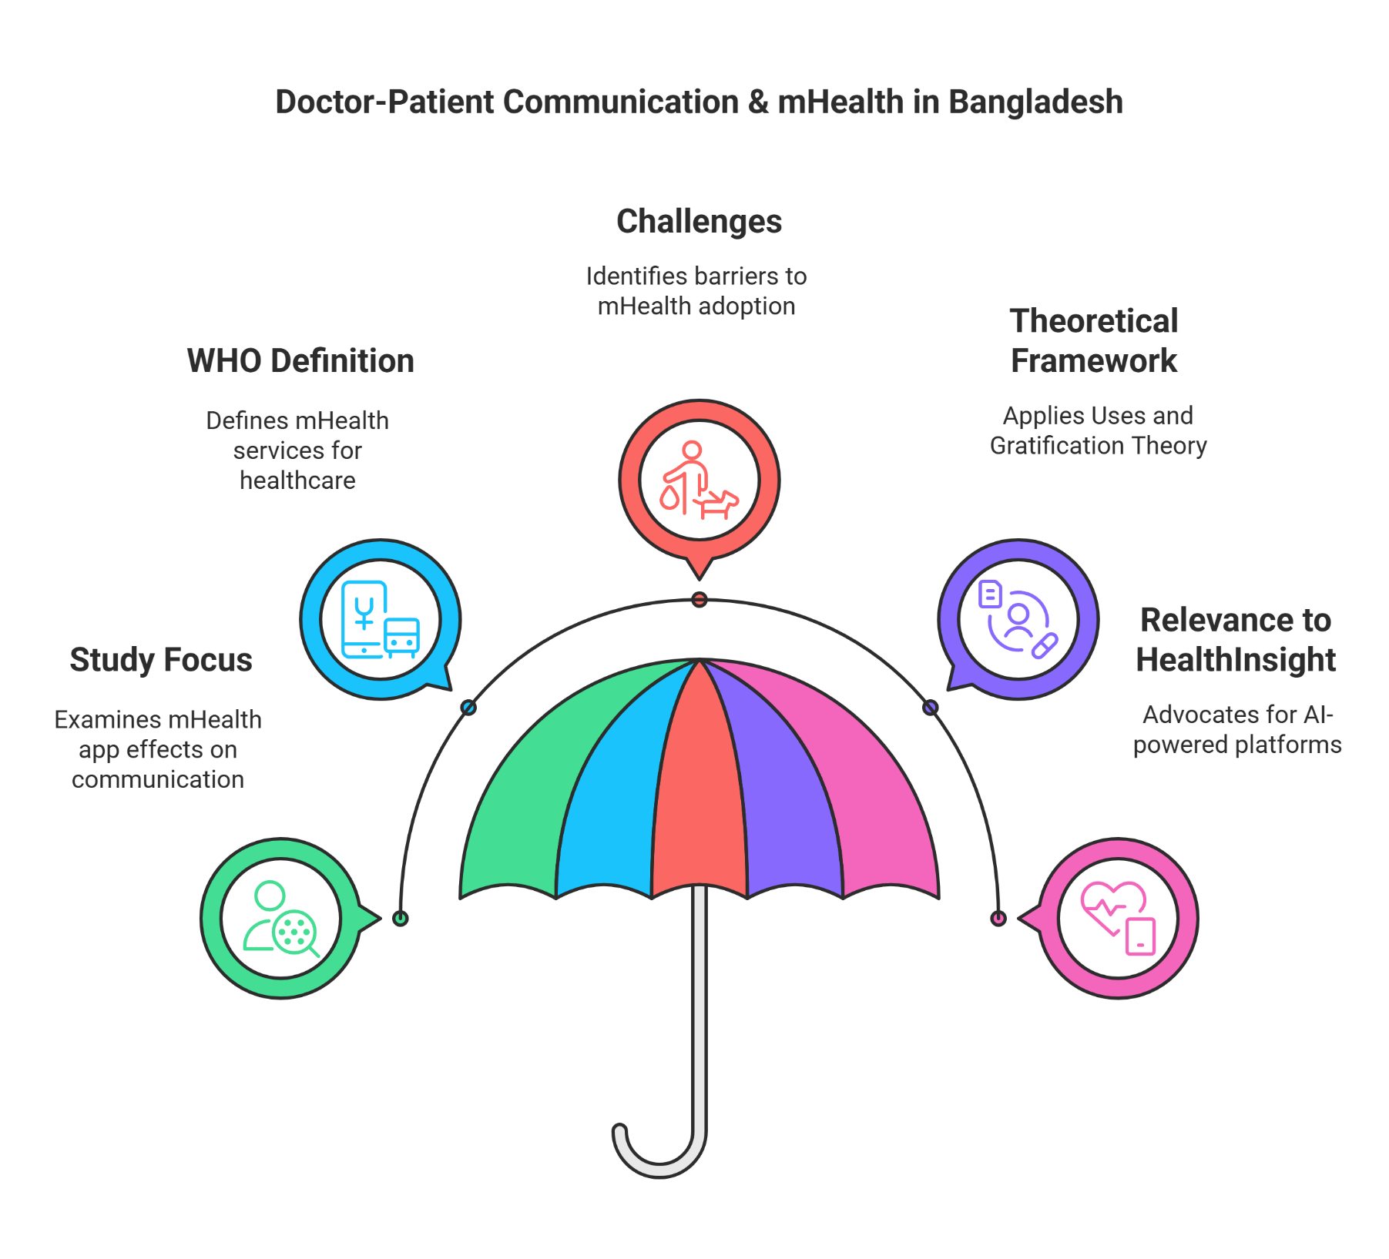
Literature Review
5

Slide 6
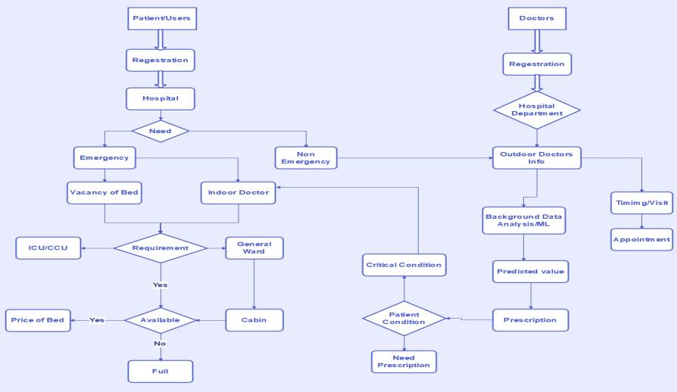
Methodology
1
Requirements Analysis & Planning
Defines system needs, feasibility study, and stakeholder consultations to refine functional specifications.
2
System Design
Architects frontend, backend, database, and APIs for seamless hospital system integration and patient management.
3
Software Development
Follows agile methodology, building UI, AI-powered recommendations, secure database, and API connections iteratively.
6

Slide 7

Methodology
Hardware Implementation
Testing
Deployment
Maintenance
Utilizes cloud servers, integration devices, and mobile/web support for seamless patient-hospital connectivity.
Conducts unit, integration, performance, security, and user acceptance testing to ensure reliability.
Beta rollout, full-scale launch, and continuous performance monitoring for optimal system functionality.
Regular updates, database optimization, scalability enhancements, and user support for sustained performance.
7

Slide 8

Project Overview
Admin Panel
Patient Section
Doctors Panel
Emergency Section
The admin dashboard allows managing users, doctors, patients, appointments, queries, session logs, reports, pages and patient searches efficiently.
The patient dashboard allows users to manage their profiles, book appointments, view appointment history and access their medical history efficiently.
The doctor dashboard enables profile management, appointment history viewing, patient details access, and disease prediction using a prediction model.
User selects hospital and disease, views pricing, picks a bed, confirms booking and completes the hospital bed reservation process.
8

Slide 9
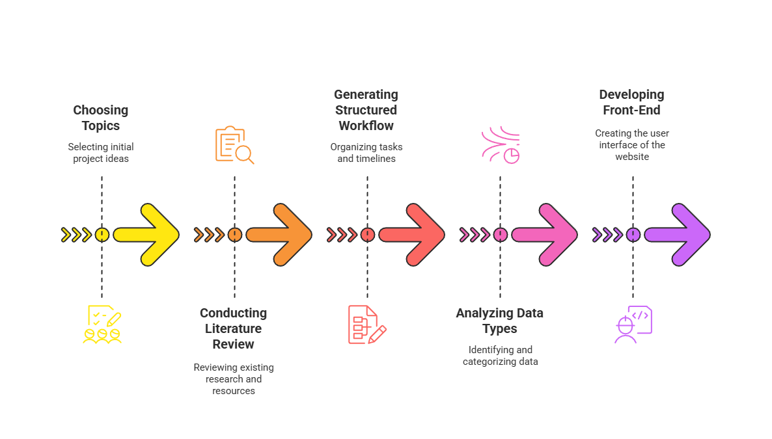
Capstone A Project Process
9

Slide 10
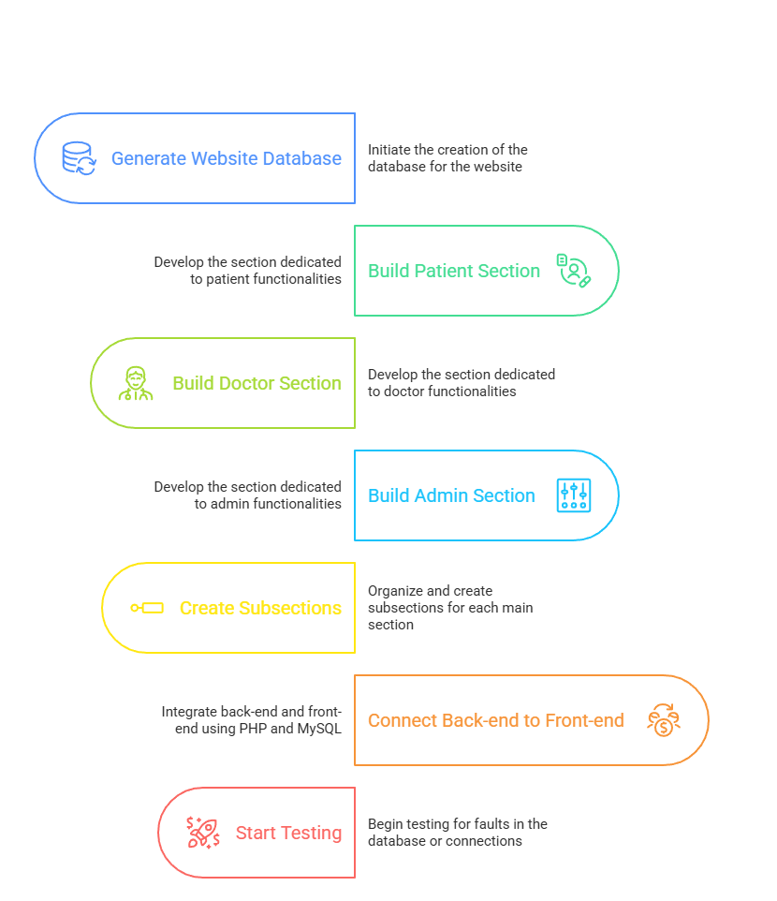
Capstone B Project Development Sequence
10

Slide 11
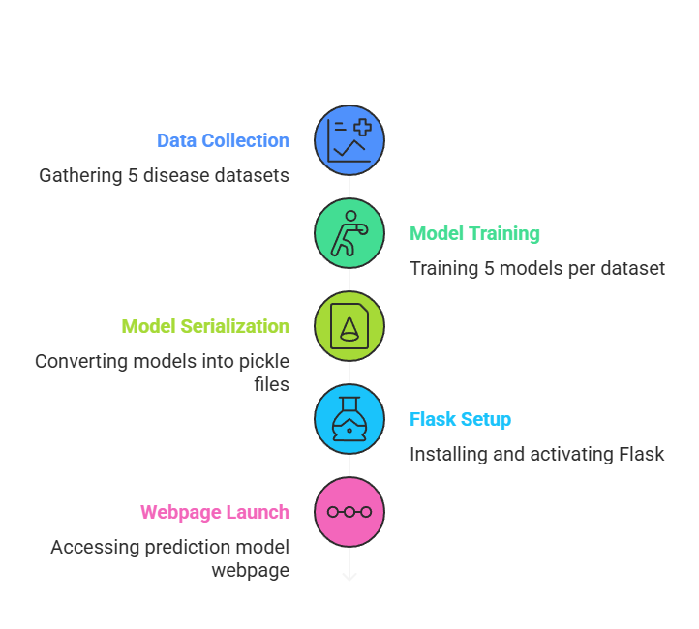
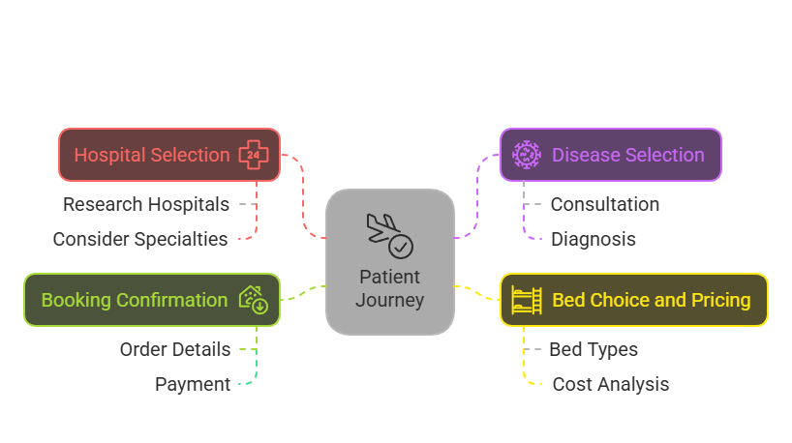
Capstone C Project Development Sequence
Prediction Model
Hospital Bed Booking
11

Slide 12
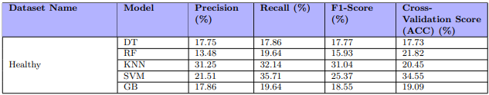
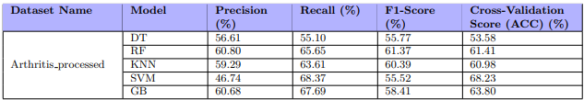
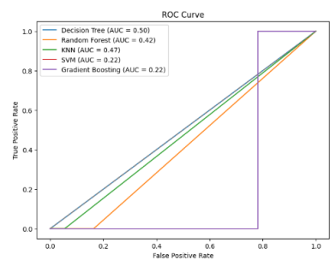
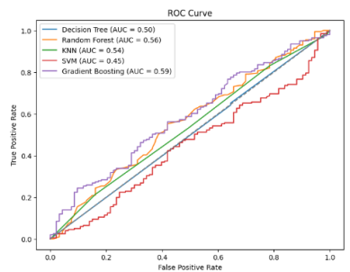
Dataset Overview
12

Slide 13
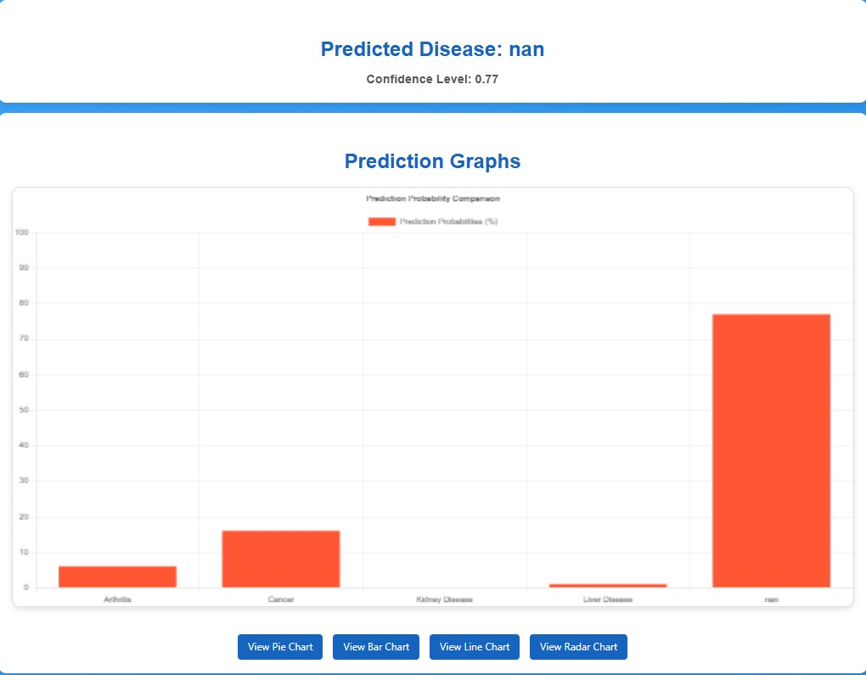
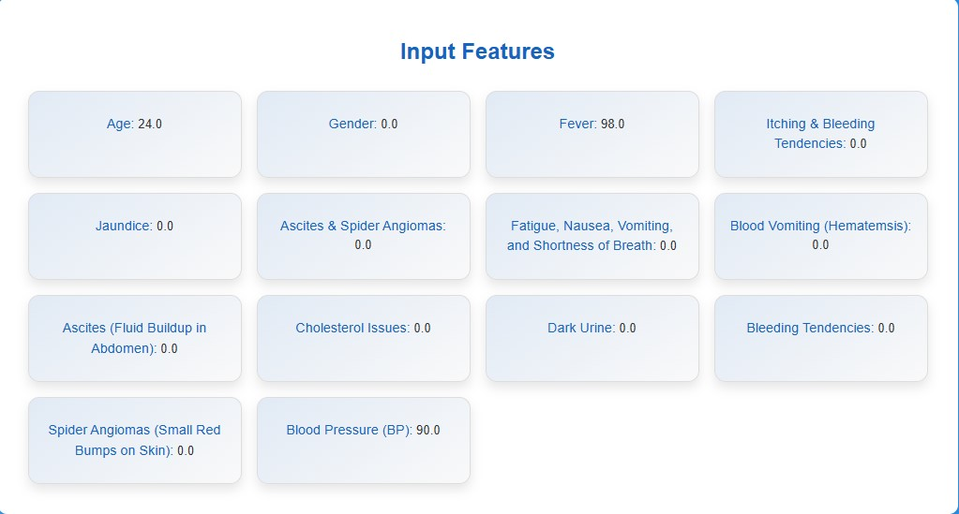
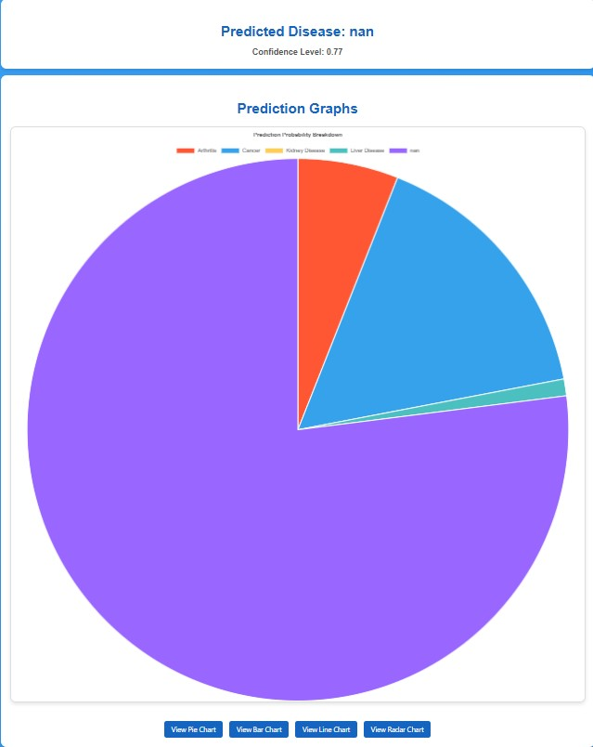
Prediction Result For Healthy Persons
The image displays AI-based health prediction results for a healthy person, using various medical input features. It includes graphical representations of prediction probabilities, but the predicted disease value is "nan," indicating no detected illness.
13

Slide 14
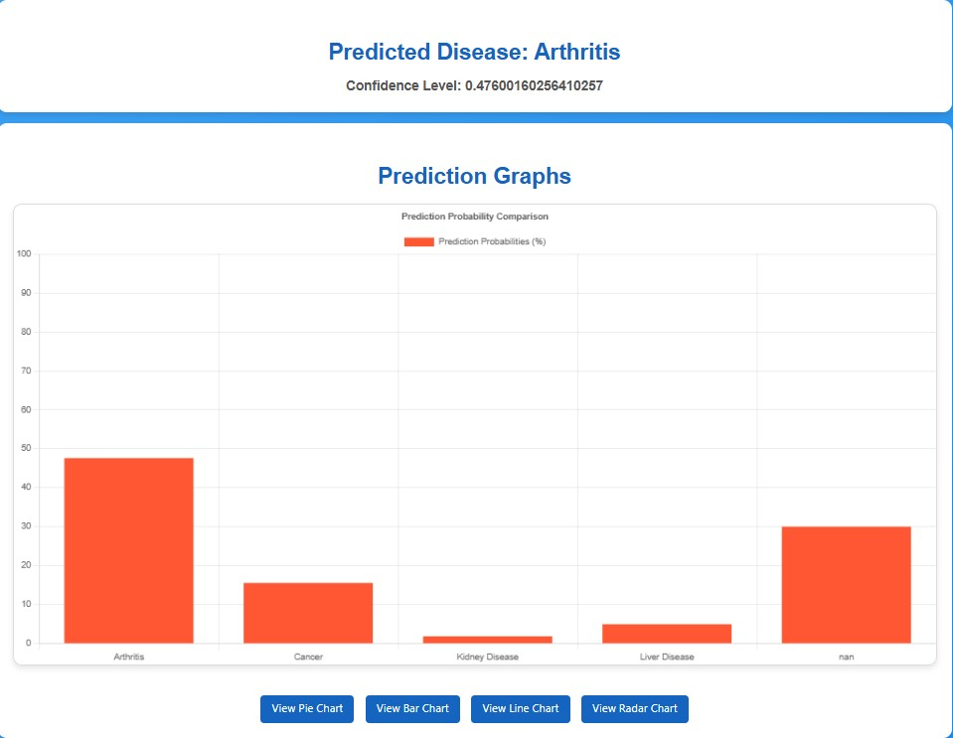
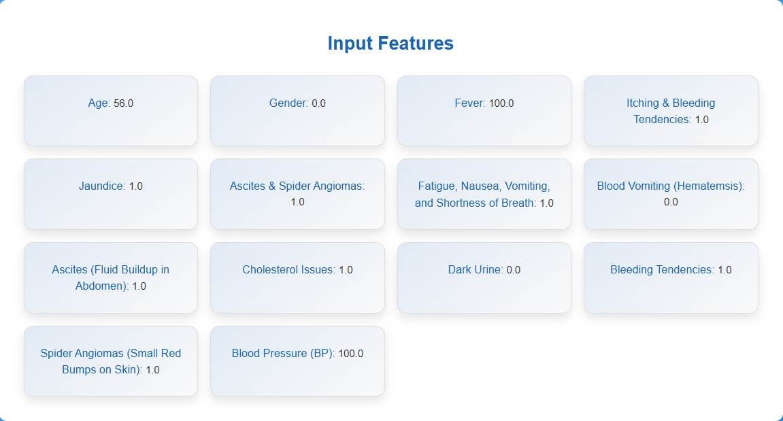
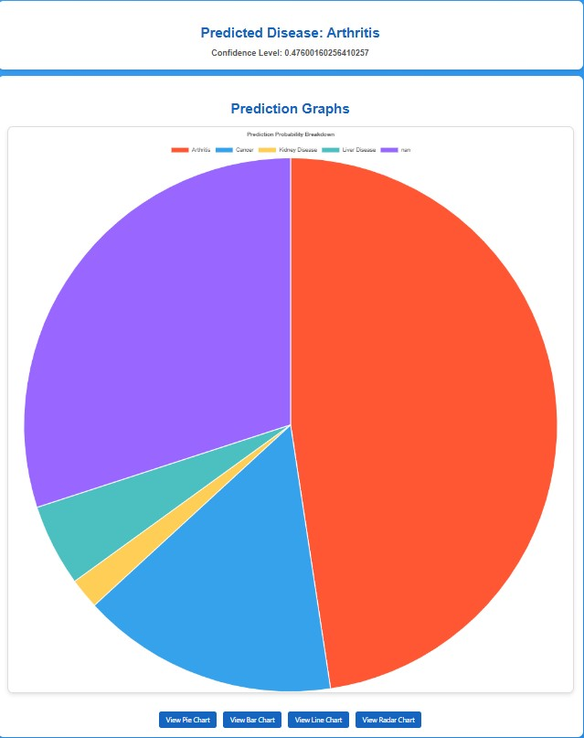
Prediction Result For Patients Disease
The image presents AI-based health prediction results for a patient, with various medical input features. The predicted disease is “Arthritis”, shown with confidence levels and visualized through bar and pie charts.
14

Slide 15
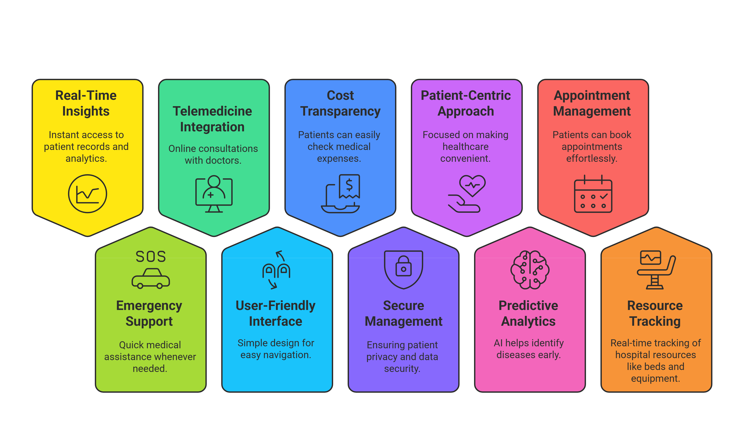
Key Features
15

Slide 16

Technology Used
Front-End
Back-End
Database
ML Framework
HTML, CSS, Bootstrap, and JavaScript
Develop a dynamic and user-friendly interface, allowing patients and doctors to easily navigate the platform, book appointments, and access health data
PHP and Flask
Handle server-side operations, manage API interactions, and process user requests for smooth communication between the client and server
MySQL
Store patient records, symptoms, medical histories, and drug properties, ensuring secure and organized data management
Dataset sources used by available platforms like Kaggle and Data
Use diverse datasets for disease classification the improve prediction accuracy, reduce bias, and ensure reliable diagnostic results

Slide 17
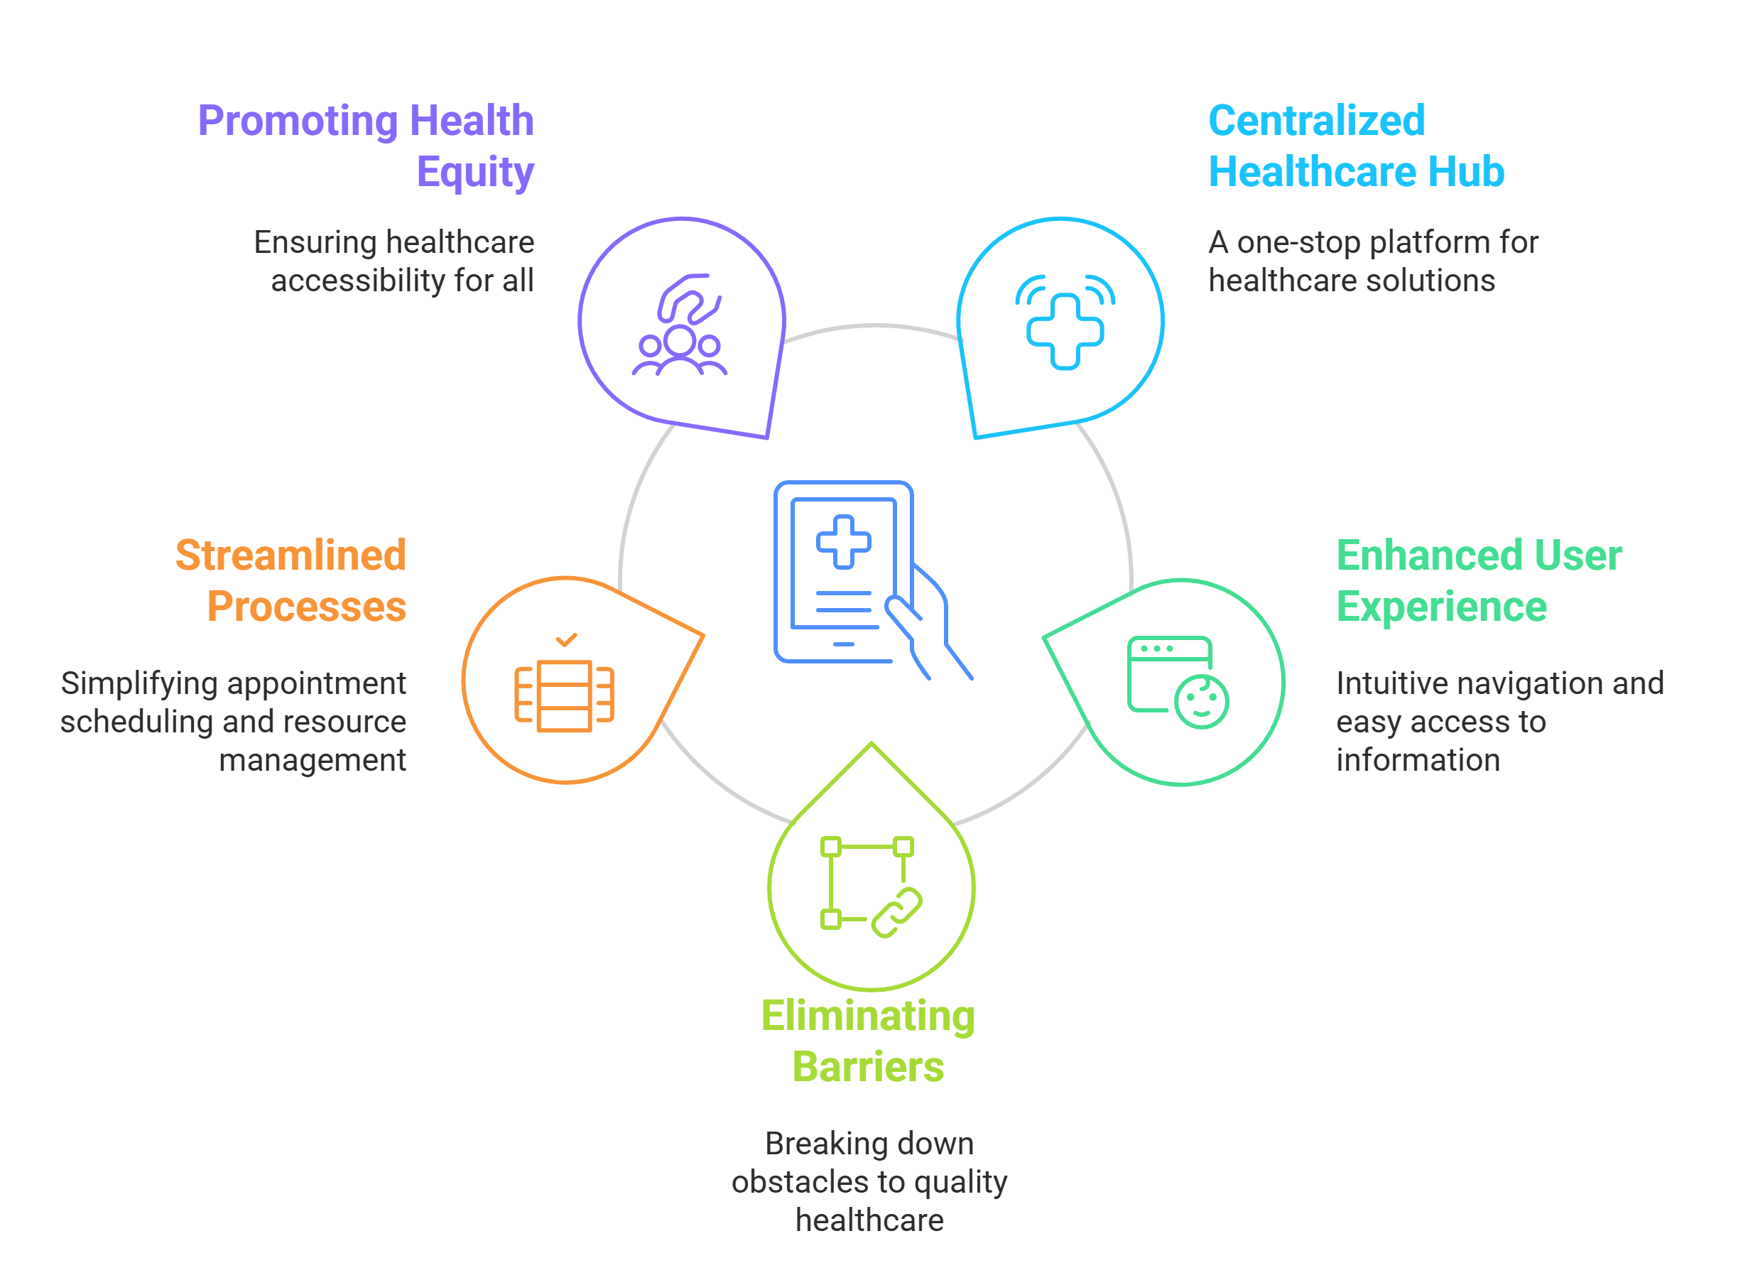
Purpose of Our Website
17

Slide 18
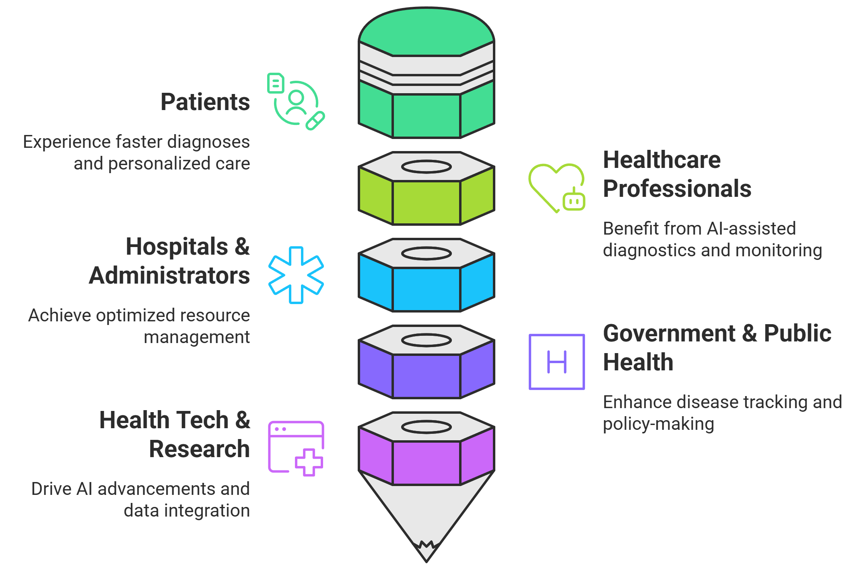
Beneficiaries of Our Website
18

Slide 19
Conclusion
HealthInsight enhances doctor-patient communication and predicts diseases using AI.
It helps doctors diagnose faster and improves access to healthcare services.
Features like remote health monitoring and bed tracking ensure timely medical care.
The system is built with Flask, PHP, and MySQL for security and efficiency.
Future upgrades will improve accuracy by adding more patient data, linking hospital records, and enhancing AI predictions.
19

Slide 20
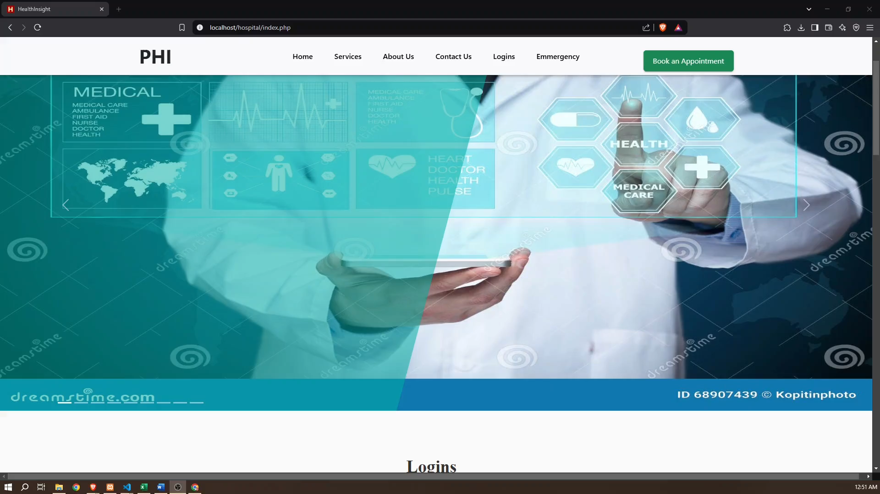
Demography
20

Slide 21

21

